Slide 1
Boosting Ensemble Learning: A comparison of XGBoost to Decision Trees and Random Forest for Supermarket Sales Prediction
Victor Irekponor
8th December, 2022

Slide 2

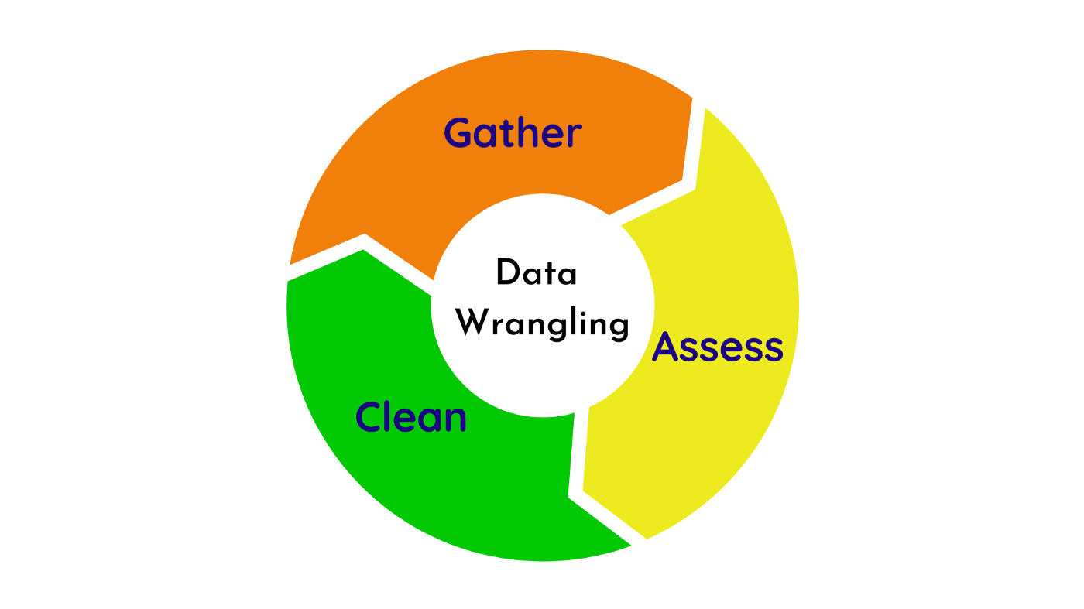
Motivation
Why is this topic of relevance?
Boosting
XGBoost – eXtreme Gradient Boosting
Dataset preparation, manipulation and wrangling
Model comparison
Hyperparameter optimization

Slide 3
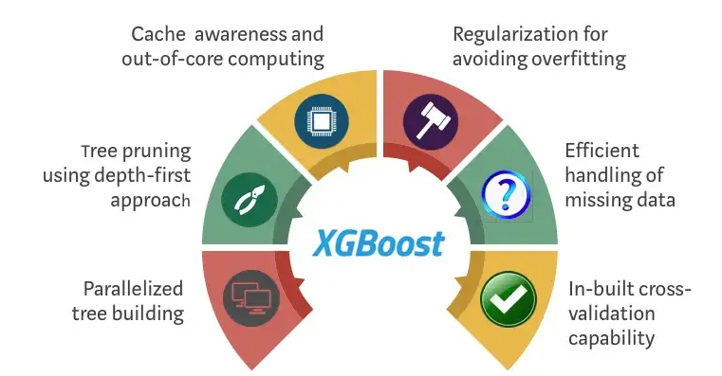
Problem
A recent publication in the just concluded NEURIPS conference confirmed that traditional machine learning models still outperform SoTA deep learning on tabular dataset.
I am interested in evaluating the performance of a tree-based ensemble technique, specifically the XGBoost model on a supermarket sales dataset, and comparing its RMSE to those obtained from decision tree and random forest algorithms which are also tree-based machine learning models.

Slide 4
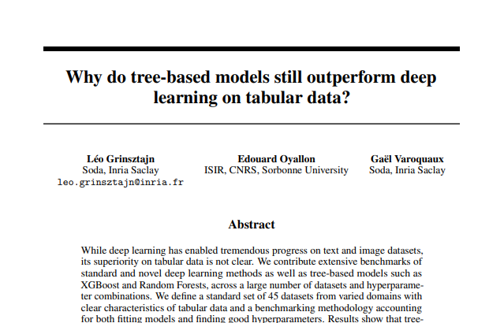
Problem cont’d

Slide 5


Data
The input data is a supermarket sales dataset, gotten from Kaggle [dot] com.
The objective is to train models, evaluate and compare their performance, and do a bit of hyperparameter optimization.
https://www.kaggle.com/

Slide 6
Methods
Data Preparation
4990 rows, 13 variables. 5 numerical, 8 categorical.
Handling Missing Data
Imputation
Removal the empty data points
Handling Categorical Variables
One-hot encoder
Label encoder
Pandas dummies etc

Slide 7
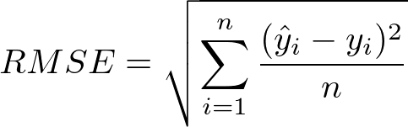



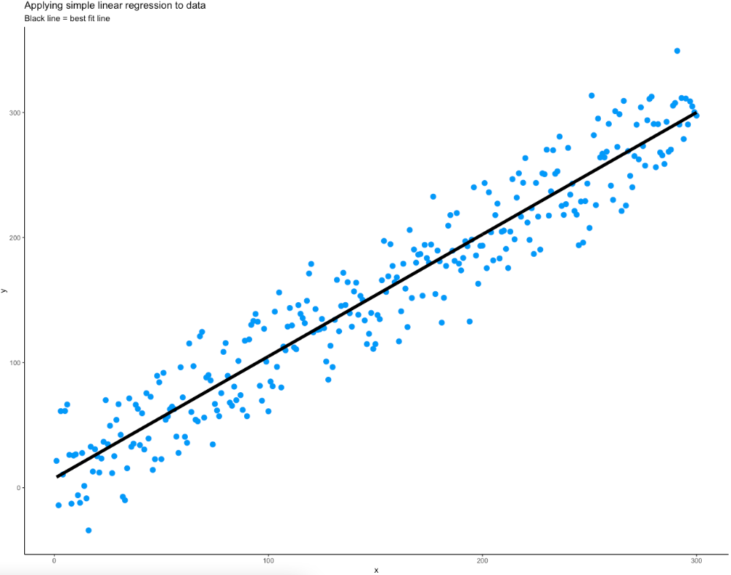
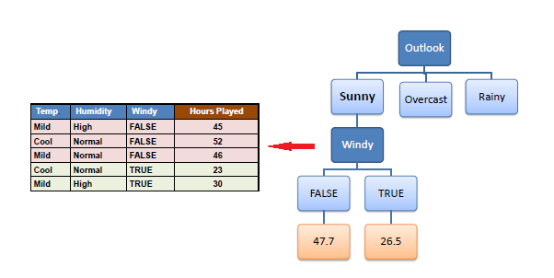
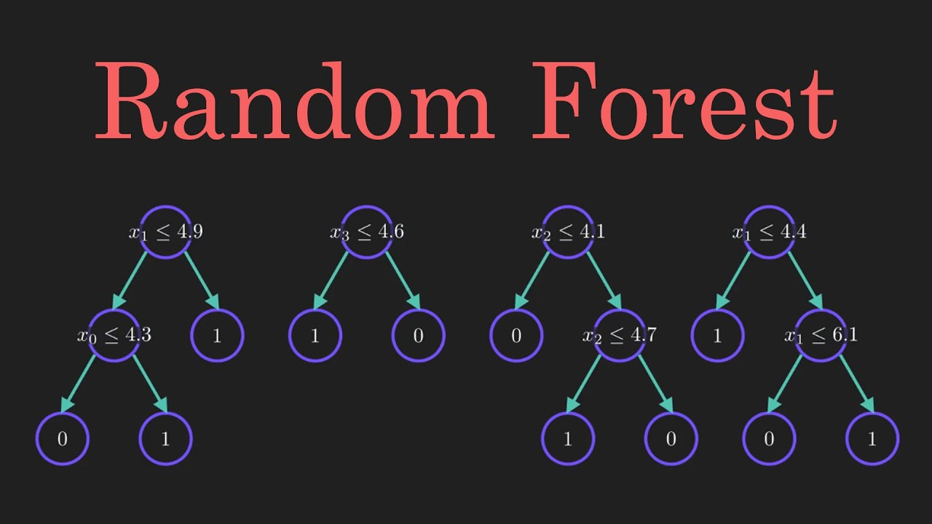
Methods
Model Training
XGBoost Regressor
75% train
25%
test
4990
Baseline Linear model
Decision Tree Regressor
Random Forest Regressor

Slide 8
Some Results
Baseline Linear model
RMSE on Validation | RMSE on Testing
3012.61 | 3399.45
Decision Tree model
Without tuning any parameter!
RMSE on Validation | RMSE on Testing
2838.87 | 3235.74
Random Forest model
RMSE on Validation | RMSE on Testing
2812.76 | 3283.433283.43
XGBoost model
RMSE on Validation | RMSE on Testing
2563.13 | 3012.43

Slide 9
Hyperparameter Optimization
Next steps:
Areas for Improvements (Which variables the major predictors of sales?)
Conclusion

